Slide 1


Himalaya Geo-Labs and Solutions
Innovating solutions for a dynamic world
Project Title: Proposed mobile application and website
(Guardian Watch)
Bridging Citizens and Law Enforcement
Presented to: Honorable Sectary Home and prison Presented By: Himalaya Geo-Labs and Solutions

Slide 2
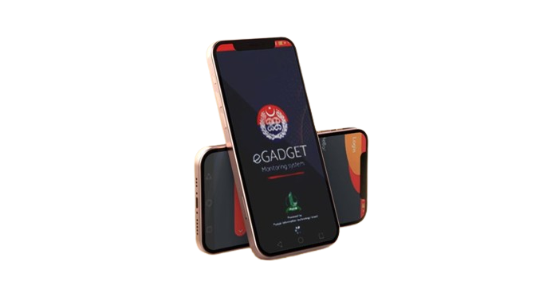
Introduction
Guardian Watch is a mobile application designed to empower citizens to actively contribute to community safety by reporting incidents or crimes they witness. The app facilitates a quick and seamless process for users to capture and share information with local law enforcement, creating a more responsive and connected community. The Solution: GuardianWatch bridges the gap by empowering citizens to actively contribute to community safety.
Key Features:
Incident Reporting with photos and videos
Real-time alerts for prompt law enforcement response
User anonymity to encourage reporting
Database management for efficient incident analysis
Community engagement through a bulletin board
Integration with emergency services for critical situations
Objective: GuardianWatch aims to revolutionize incident reporting, addressing current challenges and fostering a safer, more connected community.

Slide 3

Current Challenges in Community Safety and Incident Reporting:
Underreporting of Incidents:
Many incidents in communities go unreported due to various reasons, including fear of retaliation, lack of trust in law enforcement, or the perception that reporting won't lead to meaningful action.
Slow and Inefficient Reporting Processes:
Traditional methods of incident reporting, such as phone calls or in-person visits to police stations, can be slow and cumbersome. This may result in delayed response times and difficulty in gathering timely and accurate information.
Lack of Anonymity:
Concerns about privacy and safety often deter individuals from reporting incidents, especially if they fear repercussions. The absence of an anonymous reporting option hinders the willingness of witnesses to come forward.
Limited Community Engagement:
Many communities lack effective platforms for residents to engage with each other and law enforcement in a meaningful way. This hampers the development of a collaborative and informed community.

Slide 4
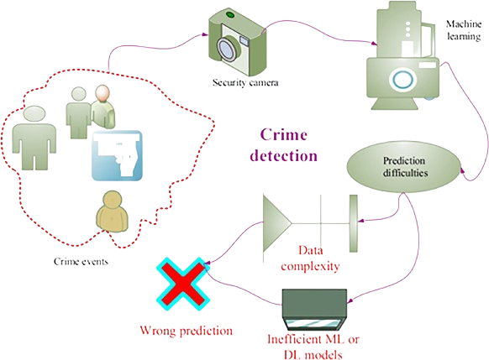
Ineffective Data Management:
Traditional paper-based or outdated digital systems for incident reporting may result in inefficient data management. Law enforcement agencies struggle to analyze and respond to incidents effectively without a streamlined and centralized database.
Communication Gaps:
Communication gaps between citizens and law enforcement can lead to misinformation, misunderstandings, and an overall lack of awareness about local safety issues.
Inadequate Integration with Emergency Services:
Limited integration with emergency services may result in delayed responses during critical situations, impacting the overall effectiveness of emergency management.
Insufficient Public Awareness:
Lack of awareness about the importance of incident reporting and community safety measures can contribute to a passive approach among citizens, preventing them from actively participating in maintaining public safety.
Failure to Address Root Causes:
Incident reporting systems sometimes focus solely on documenting incidents without addressing the underlying causes. This can hinder the development of long-term solutions for community safety.
Challenges in Community Policing:
Community policing efforts face challenges in building trust and fostering positive relationships between law enforcement and residents, affecting the overall effectiveness of community safety initiatives

Slide 5

Bridging the Gap: Traditional Incident Reporting Challenges
Gap in Traditional Reporting:
Speed and Efficiency: Traditional methods like phone calls or in-person visits are slow and often result in delayed responses.
Limited Information: Lack of comprehensive data due to paper-based or outdated digital systems hampers incident analysis.
Importance of Active Citizen Participation:
Timely Reporting: Active citizen involvement is crucial for timely and accurate incident reporting.
Community Empowerment: Engaged citizens contribute to a safer community, fostering a sense of responsibility and collaboration.

Slide 6

Guardian Watch Overview Key Features: Incident & Suspicious Activity Reporting: Users can report incidents by capturing photos or videos using the in-app camera. Include a brief description of the incident, along with relevant details. Option to categorize incidents (e.g., theft, vandalism, assault) for better classification. Location Tagging, The app automatically attaches the GPS location to the reported incident for accurate mapping, Users can also manually input additional details about the location if needed Real-Time Alerts.
Community Policing Partnerships:
Establish partnerships with local community policing initiatives, neighborhood watch programs, or other community organizations to enhance the effectiveness of Guardian Watch. Localized Incident Heat maps:
Develop localized incident heat maps within the app to highlight areas with higher reported incidents, helping both users and law enforcement identify trends and allocate resources strategically.
Real-Time Alerts :
once an incident is reported, the app sends an immediate alert to the nearest police station.
Police officers receive real-time notifications with details of the incident and location.

Slide 7
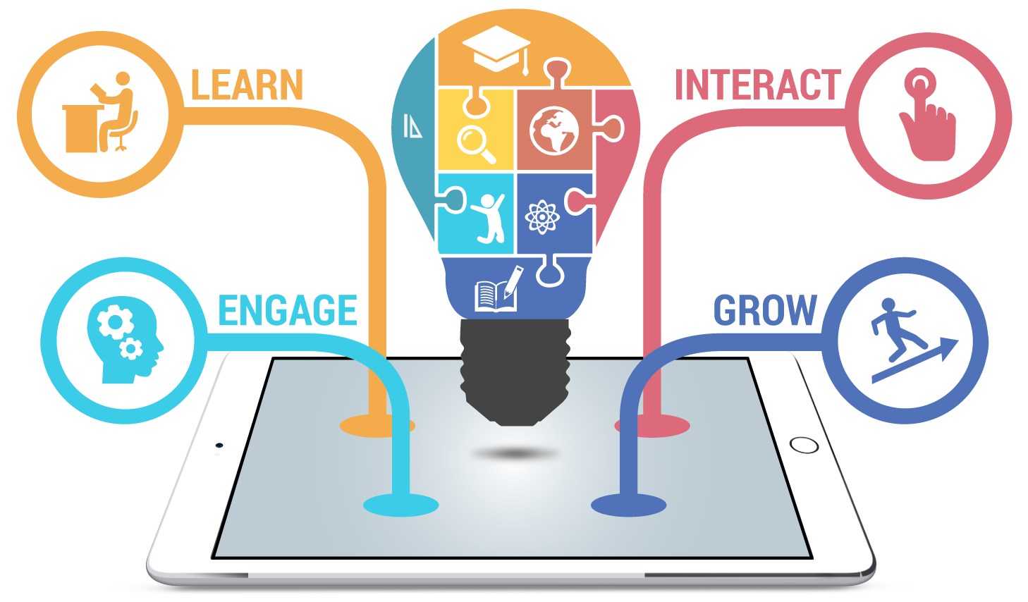
Guardian Watch Overview
Public Awareness Campaigns:
Launch public awareness campaigns to promote the app, educate citizens on its benefits, and emphasize the positive impact of their contributions to community safety. Collaboration with Schools:
Collaborate with local schools to introduce Guardian Watch as part of educational programs, teaching students about civic responsibility and community safety.
User Anonymity:
To encourage reporting, users have the option to remain anonymous.
Anonymous reports still provide valuable data to utility companies without compromising user identity.
Database Management:
The utility company's headquarters hosts a secure web-based database.
All reported incidents are stored, creating a comprehensive record for analysis and future reference.
Search and filter options for utility company personnel to efficiently manage and investigate incidents.
Feedback Mechanism:
Users receive updates on the status of their reported incidents.
Utility company personnel can request additional information or provide feedback on resolved cases.

Slide 8
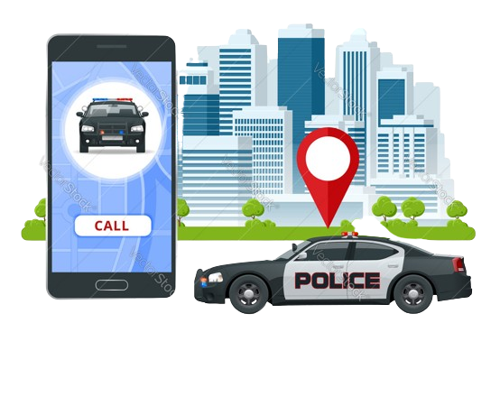
Seamless Incident Reporting with Guardian Watch
Open the App:
Users start by launching the Guardian Watch app on their smartphones.
Capture Incident:
Use the in-app camera to capture photos or videos of the incident.
Add Details:
Provide a brief description of the incident and relevant details.
Categorize Incident:
Choose from predefined categories (e.g., theft, vandalism, assault) for better classification.
Location Tagging:
Guardian Watch automatically attaches the GPS location for accurate mapping.
Users can also manually input additional location details if needed.
Submit Report:
Users submit the incident report with a simple tap.
Real-Time Alert:
The app sends an immediate alert to the nearest police station.
Police Notification:
Law enforcement receives real-time notifications with incident details and location.

Slide 9
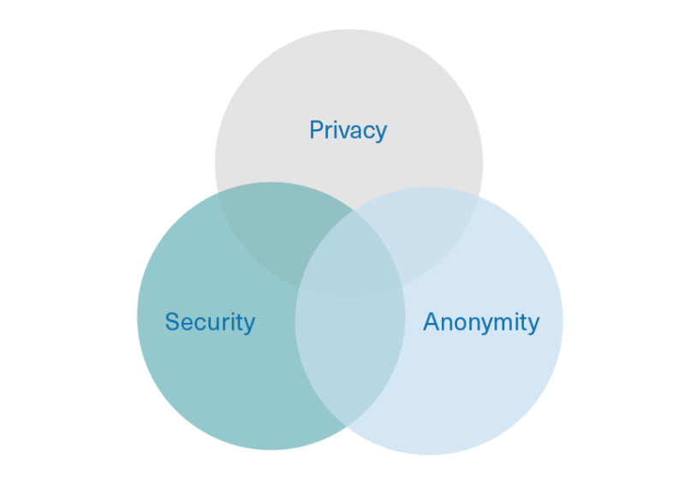

User Anonymity and Security
Ensuring Privacy and Security with GuardianWatch
User Anonymity:
Option for Anonymity: Users have the choice to submit reports anonymously.
Encouraging Cooperation: Anonymity fosters trust, encouraging more individuals to report incidents without fear of retaliation.
Data Encryption:
Secure Transmission: GuardianWatch employs state-of-the-art encryption protocols for the secure transmission of data.
Protecting Identities: Robust encryption measures are in place to safeguard user identities.
Secure Database:
Centralized and Secure: The police department's headquarters hosts a secure web-based database.
Limited Access: Access to the database is restricted to authorized personnel for data integrity and privacy

Slide 10
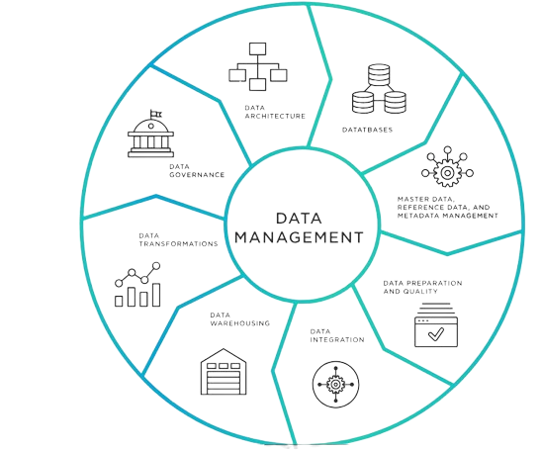
Database Management
Empowering Law Enforcement Through Robust Database Management
Content:
Centralized Database:
Secure Web-Based Hub: Guardian Watch's centralized, secure database is hosted at the police department's headquarters.
Comprehensive Record: All reported incidents are systematically stored, creating a comprehensive and easily accessible record.
Efficient Incident Analysis:
Search and Filter Options: Law enforcement can utilize search and filter options for efficient incident analysis.
Timely Responses: Quick access to incident data enables law enforcement to respond promptly to reported incidents.
Strategic Planning:
Data-Driven Policing: The database serves as a foundation for data-driven policing strategies.
Identifying Trends: Law enforcement can identify patterns and trends to allocate resources strategically.

Slide 11


Community Engagement
Fostering Community Collaboration with GuardianWatch
Content:
Community Bulletin Board:
Interactive Platform: GuardianWatch features a community bulletin board.
Sharing Information: Residents can share safety tips, crime prevention advice, and updates on resolved incidents.
Promoting Collaboration:
Open Discussions: Users can engage in discussions, fostering a sense of community awareness.
Collaborative Efforts: The bulletin board promotes collaboration between citizens and law enforcement.
Visuals of Community Discussions:
Screenshots: Display visuals of community members actively participating in discussions.
User Collaboration: Showcase examples of how users collaborate on the platform.

Slide 12

Incident Reporting Features
Enhancing Incident Reporting with GuardianWatch
Incident Reporting:
Capture Evidence: Users can report incidents by capturing photos or videos using the in-app camera.
Detailed Descriptions: Include a brief description of the incident, providing relevant details.
Categorization for Classification:
Enhanced Classification: Users have the option to categorize incidents (e.g., theft, vandalism, assault) for better classification and streamlined analysis.
Location Tagging:
Automatic GPS Attachment: The app automatically attaches the GPS location to the reported incident, ensuring accurate mapping.
Manual Input Option: Users can also manually input additional details about the location if needed.
Real-Time Alerts:
Prompt Notifications: Once an incident is reported, GuardianWatch sends real-time alerts to the relevant authorities.
Efficient Communication: Police officers receive immediate notifications with details of the incident and its location.

Slide 13


Community Policing Partnerships
Strengthening Community Safety Through Partnerships
Establishing Collaborative Partnerships:
GuardianWatch actively seeks partnerships with local community policing initiatives, neighborhood watch programs, and other community organizations.
Shared Goals and Objectives:
Aligning with the missions of community policing initiatives to create safer and more connected neighborhoods.
Working together towards common goals of enhancing community safety and engagement.
Collaborative Initiatives:
Joint community outreach programs, events, and initiatives that promote awareness and active participation.
Engaging with neighborhood watch programs to leverage their local insights and expertise.
Enhancing Effectiveness:
Leveraging the collective efforts of GuardianWatch users, law enforcement, and community organizations to maximize the impact on community safety.

Slide 14
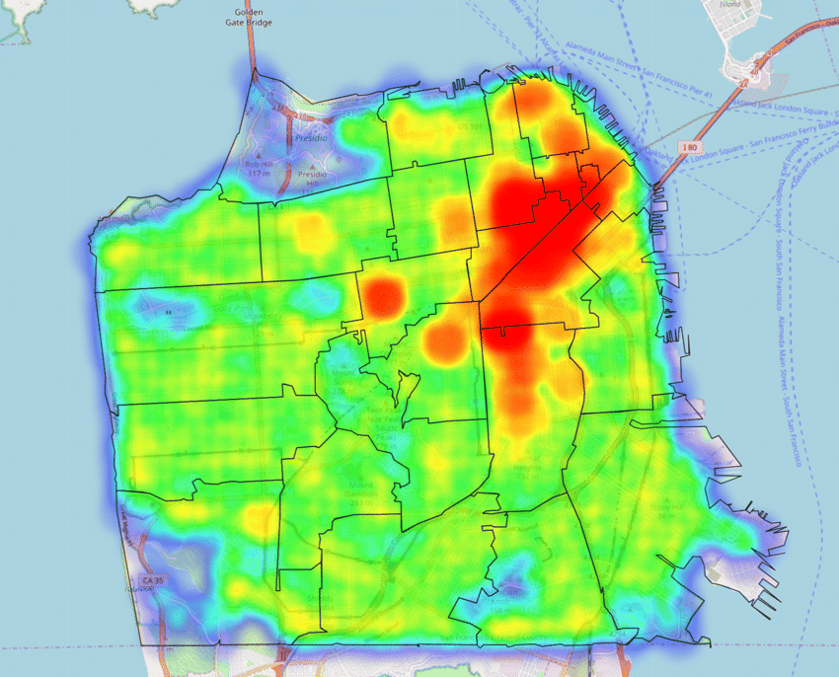
Localized Incident Heat Maps
Strategic Resource Allocation through Incident Heat Maps
Localized Incident Heat Maps:
GuardianWatch integrates localized incident heat maps within the app.
These maps dynamically display areas with higher reported incidents, offering a visual representation of community safety trends.
User-Friendly Visualization:
Intuitive design for easy interpretation by both users and law enforcement.
Heat map colors indicate the intensity of reported incidents, facilitating quick analysis.
Identifying Trends:
Users can identify patterns and trends in incident occurrences based on the heat maps.
Law enforcement gains valuable insights into areas that may require additional attention or resources.
Strategic Resource Allocation:
Empowering law enforcement to strategically allocate resources based on real-time incident data.
Users can make informed decisions about their activities and movements within the community.

Slide 15
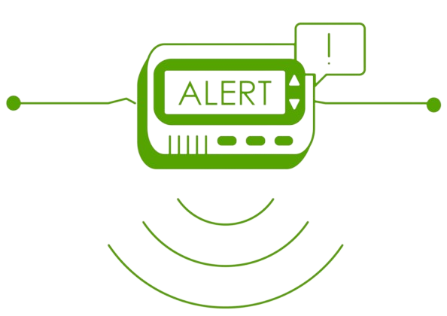

Real-Time Alerts
Swift Response with Guardian Watch's Real-Time Alerts
Immediate Incident Notification:
GuardianWatch ensures real-time alerts by immediately notifying the nearest police station once an incident is reported.
This rapid notification system is designed to enhance the speed of emergency response.
Details at a Glance:
Police officers receive real-time notifications with comprehensive details of the reported incident.
Information includes incident description, relevant details, and the precise location of the incident.
Efficient Communication:
The real-time alert system fosters efficient communication between GuardianWatch users and law enforcement.
Police officers can quickly assess the situation and initiate a timely response.

Slide 16

Public Awareness Campaigns
Empowering Communities Through Awareness: GuardianWatch
Purpose of Public Awareness Campaigns:
GuardianWatch launches comprehensive public awareness campaigns to promote the app within the community.
Educating Citizens on App Benefits:
Informing citizens about the features and benefits of GuardianWatch.
Highlighting how the app contributes to community safety and engagement.
Positive Impact of Citizen Contributions:
Emphasizing the positive impact citizens can make by actively using GuardianWatch.
Showcasing success stories and testimonials to inspire community involvement.
Multi-Channel Approach:
Utilizing various channels, including social media, community events, and local outreach programs, to maximize reach.
Engaging local influencers and community leaders to endorse the app.

Slide 17

Public Awareness Campaigns
Spreading the Word: GuardianWatch Awareness Initiatives
Multi-Channel Promotion:
Utilize diverse channels such as social media, local news, and community events for widespread promotion.
Engage in strategic partnerships with local influencers and community leaders to amplify reach.
Educational Initiatives:
Develop educational materials explaining Guardian Watch's features and benefits.
Collaborate with schools, community centers, and local organizations to integrate awareness into educational programs.
Community Events:
Host community events to directly interact with residents.
Conduct live demonstrations, Q&A sessions, and distribute promotional materials.
Local Media Engagement:
Partner with local media outlets for featured stories, interviews, and advertisements.
Leverage local publications and radio to reach a diverse audience.

Slide 18

Collaboration with Schools
Fostering Civic Responsibility: GuardianWatch in Education
Introduction to Educational Collaboration:
GuardianWatch actively collaborates with local schools to introduce the app as part of educational programs.
Teaching Civic Responsibility:
Integrating GuardianWatch into educational curricula to teach students about civic responsibility and community safety.
Empowering the younger generation to actively participate in maintaining a safe community.
Hands-on Learning Experience:
Providing students with a practical, hands-on learning experience by using GuardianWatch to understand the importance of incident reporting.
Encouraging students to become proactive contributors to community safety.
Partnership Benefits:
Illustrating the benefits of this collaboration for both schools and the community.
Enhancing community and school relationships through shared initiatives.

Slide 19
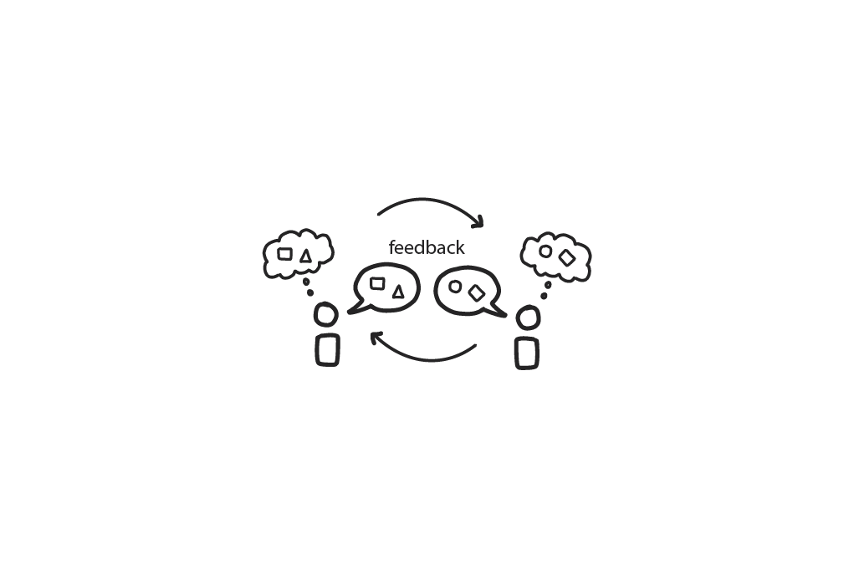
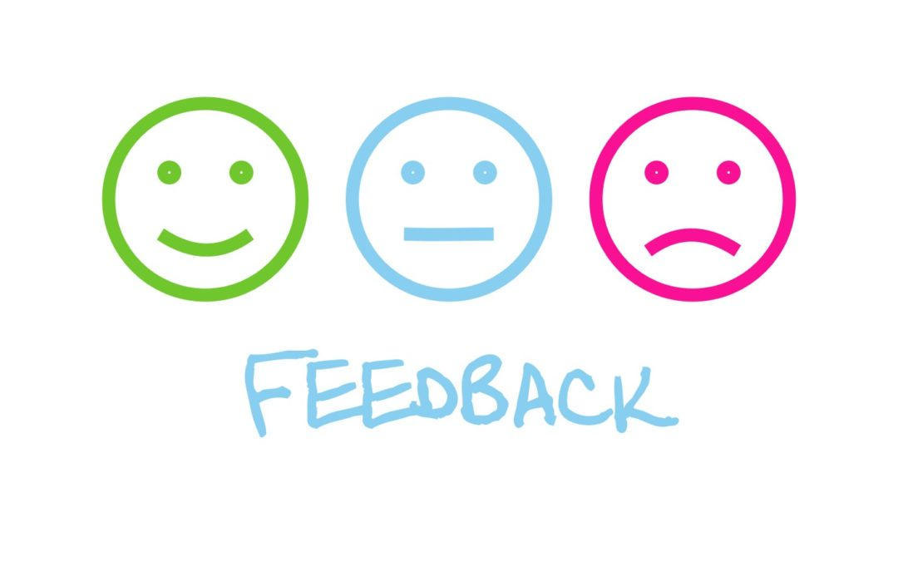
Feedback Mechanism
Transparent Communication: Guardian Watch's Feedback Loop
User Updates:
GuardianWatch ensures users receive timely updates on the status of their reported incidents.
Transparent communication keeps users informed throughout the resolution process.
Two-Way Communication:
Users have the opportunity to engage in two-way communication with utility company personnel.
Personnel can request additional information from users, fostering a collaborative approach to incident resolution.
Efficient Resolution Process:
The feedback mechanism facilitates efficient communication, leading to quicker incident resolution.
Users feel engaged and informed, contributing to overall satisfaction.
Building Trust:
Building trust between users and utility company personnel through open and responsive communication.
Encouraging ongoing user participation in incident reporting.

Slide 20

Benefits
Title: Unlocking Positive Change: Guardian Watch's Impact
Enhanced Community Safety:
Active citizen participation through GuardianWatch contributes to a safer and more secure community.
Collective efforts lead to increased vigilance and incident prevention.
Quick Response:
Real-time alerts and efficient incident reporting enable swift responses from law enforcement.
GuardianWatch ensures timely intervention, minimizing potential risks.
Data-Driven Policing:
The app's comprehensive database facilitates data-driven policing strategies.
Law enforcement gains insights into incident patterns, allowing for strategic resource allocation.
Community Building:
GuardianWatch fosters a sense of community by promoting collaboration and open communication.
Users actively engage in discussions, strengthening the community fabric.

Slide 21

Future Developments
Evolving Together: Guardian Watch's Vision for the Future
Continuous Improvement:
GuardianWatch is committed to continuous improvement.
Regular updates and enhancements to refine user experience and functionality.
User Feedback Integration:
Actively seeking and integrating user feedback into future updates.
Users are integral to shaping the evolution of GuardianWatch.
Expansion and Innovation:
Future plans include expanding features and introducing innovative functionalities.
GuardianWatch aims to stay at the forefront of technology for enhanced community safety.
Community Collaboration:
Engaging the community in the development process.
GuardianWatch envisions a collaborative journey with users in shaping the app's future.
Visuals:
Graphics representing an evolving app icon or symbol.
Images suggesting innovation and growth.

Slide 22

Call to Action
Empower Your Community: Download and Collaborate with GuardianWatch
Download GuardianWatch:
Empower yourself and your community by downloading GuardianWatch today.
Activate Your Guardian Role:
Be an active contributor to community safety. Your reports make a difference.
Encourage friends, family, and neighbors to join the GuardianWatch community.
Collaborate with Local Law Enforcement:
GuardianWatch invites collaboration with local law enforcement agencies.
Strengthen the bond between citizens and law enforcement for a safer community.
Forge Partnerships with Community Organizations:
Community organizations play a vital role. Partner with GuardianWatch to enhance community safety.
Collaborate on events, initiatives, and educational programs to promote awareness and engagement.

Slide 23

Open Floor for Questions:
We welcome your questions and insights.
Please feel free to ask anything about GuardianWatch

